Slide 1
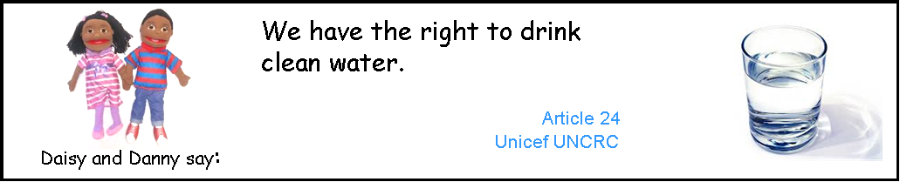

Slide 2
What do we need clean water for?

Slide 3
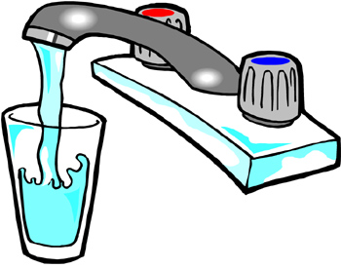
We need clean water to drink.
Keeps us healthy
Keeps our skin hydrated and body at the right temperature
Helps us digest our food
Protects our organs and gives us energy

Slide 4
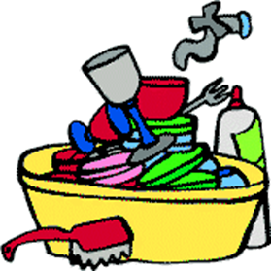
We need clean water to wash dishes.
So we can eat with clean plates, cups, cutlery to stop germs getting in to our body.

Slide 5
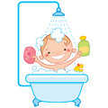
We need clean water to wash ourselves.
To stay nice and clean and get rid of all the germs on our bodies.
To wash our faces in the morning.
To wash our hands before eating and to get rid of germs

Slide 6
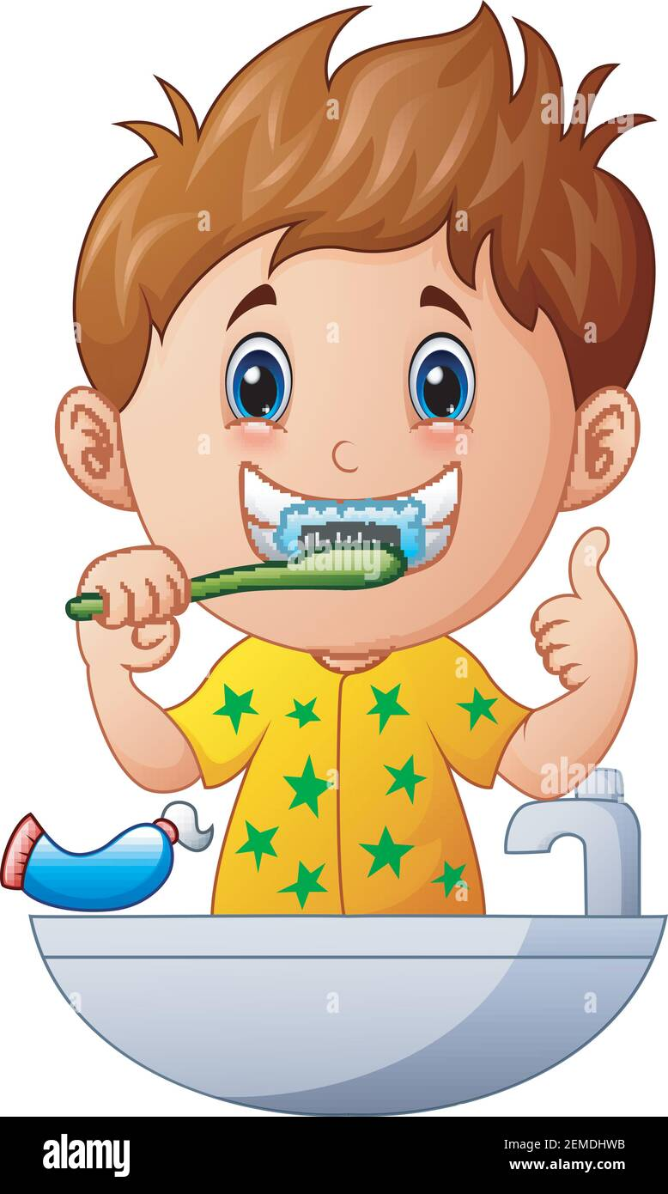
We need clean water to brush our teeth.
To avoid tooth decay, so our teeth stay clean and healthy.

Slide 7
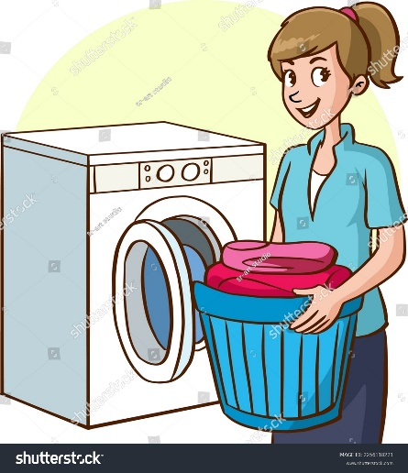
We need clean water to wash our clothes.
To make them clean to wear again, so we can get rid of any germs on our clothes.

Slide 8
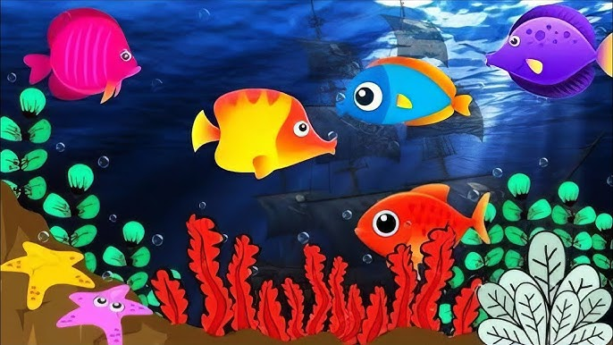
We need clean water for animals and pets.
So some animals can stay alive
So they can drink water
So we can wash and clean our pets

Slide 9
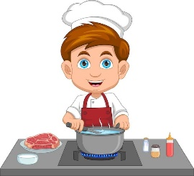
We need clean water for cooking.
To add to our food and recipes.
To wash our foods before eating

Slide 10
Practical activity
(Resources: 1 cup of brown dirty water, a bowl with dirty water- add some black paint and mud/sticks, 1 plate, a bowl of clean water).
Look at the water in the cup. What colour is this water? Can we drink this water? Why not?
Try to wash the plate in the bowl of dirty water. Why is it not possible to clean they plate? How can we make the plate clean?

Slide 11
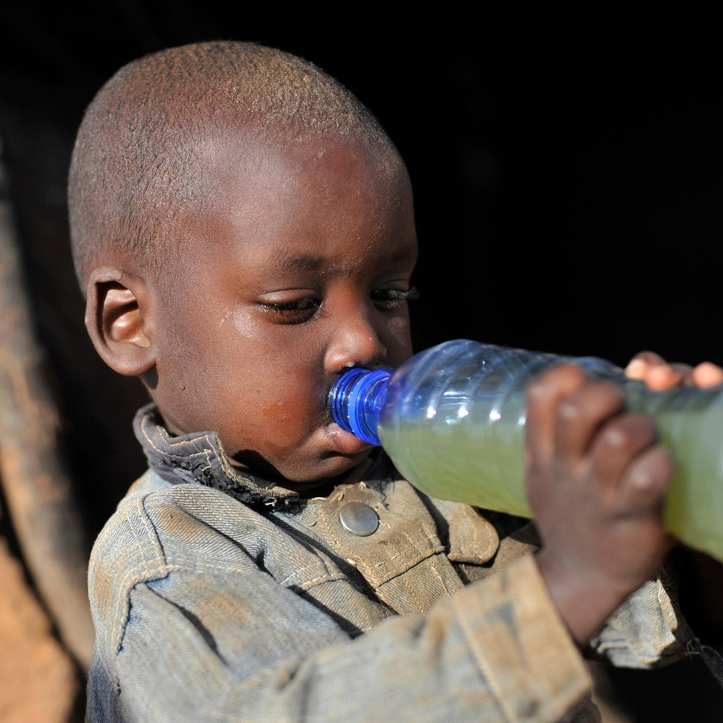
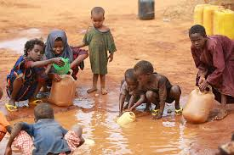
Clean water is important for life and health.
It is difficult for some children around the world to get clean water.

Slide 12
What can we do to help children around the world get clean water?
-Can we help them?
-Who can help them?
-How can we help them?

Slide 13
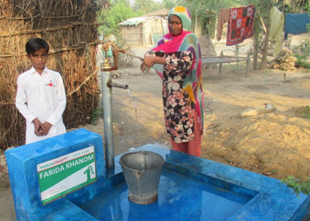
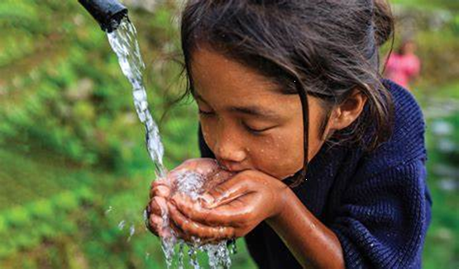
We can make a water pump in a poor country so children can have access to clean water.

Slide 14
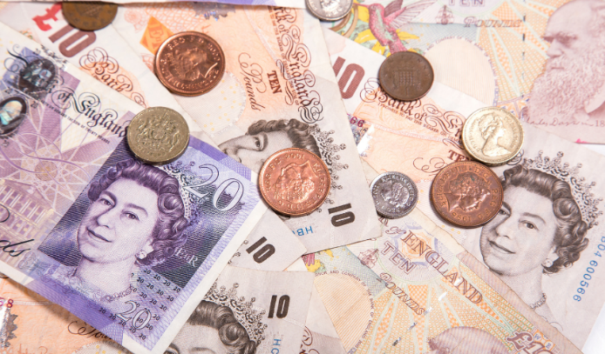
We will need to collect money to make this water pump for the children.
We need a total of £150
How can we collect this money?
Do you have any ideas?

Slide 15

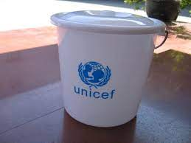
We can collect money using donation buckets.
Gather other ideas children have and share with RRSA lead.

