Slide 1
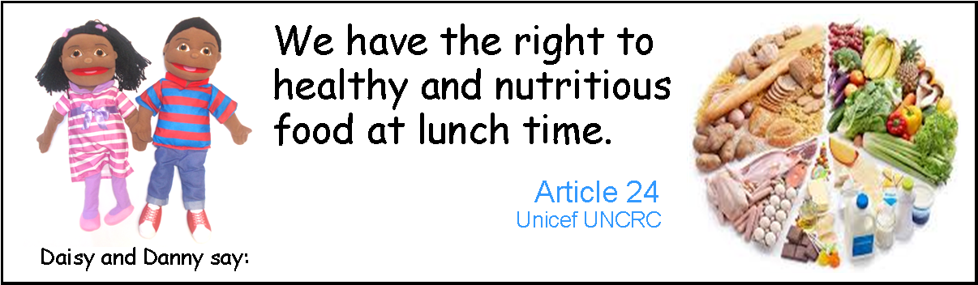

Slide 2
What is healthy food?
-Food that is good for our bodies
-We should eat lots of healthy food
Can you think of any foods that are healthy?

Slide 3
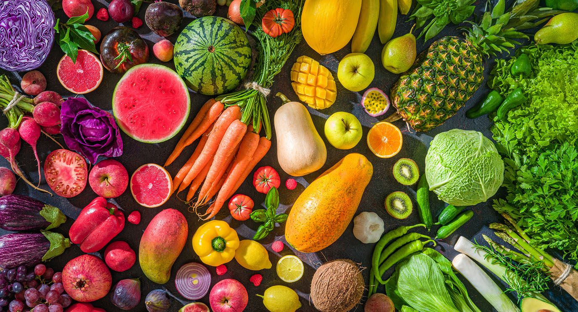
Fruits and vegetables give us energy.
What is your favourite fruit/ vegetable?

Slide 4
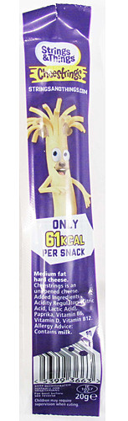
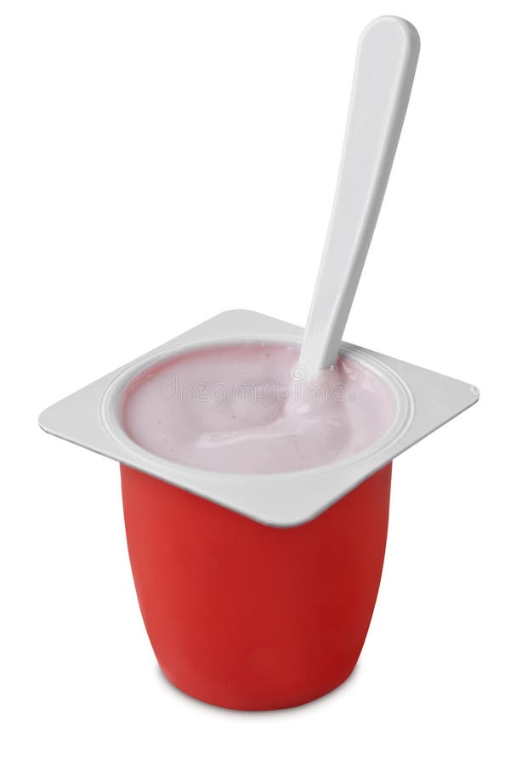
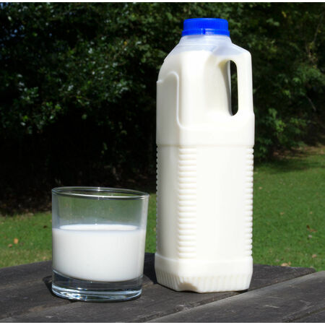
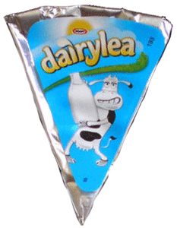
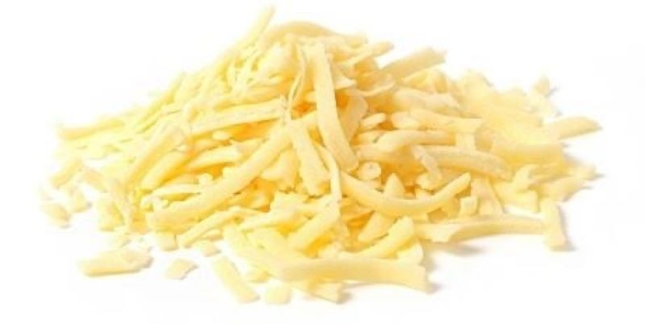
Milk, yogurt and cheese help our bones grow strong.

Slide 5
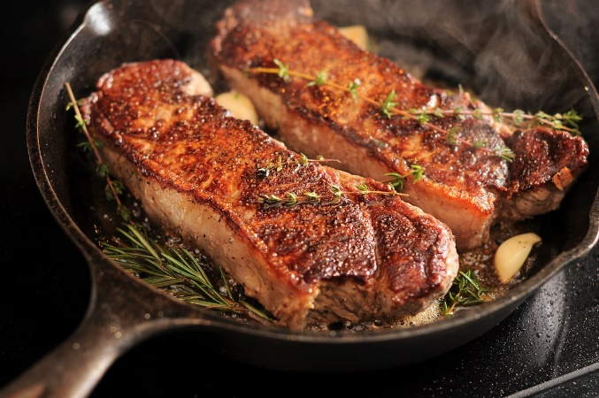
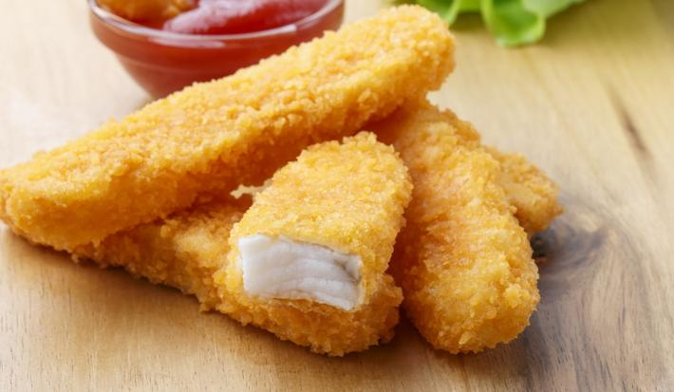
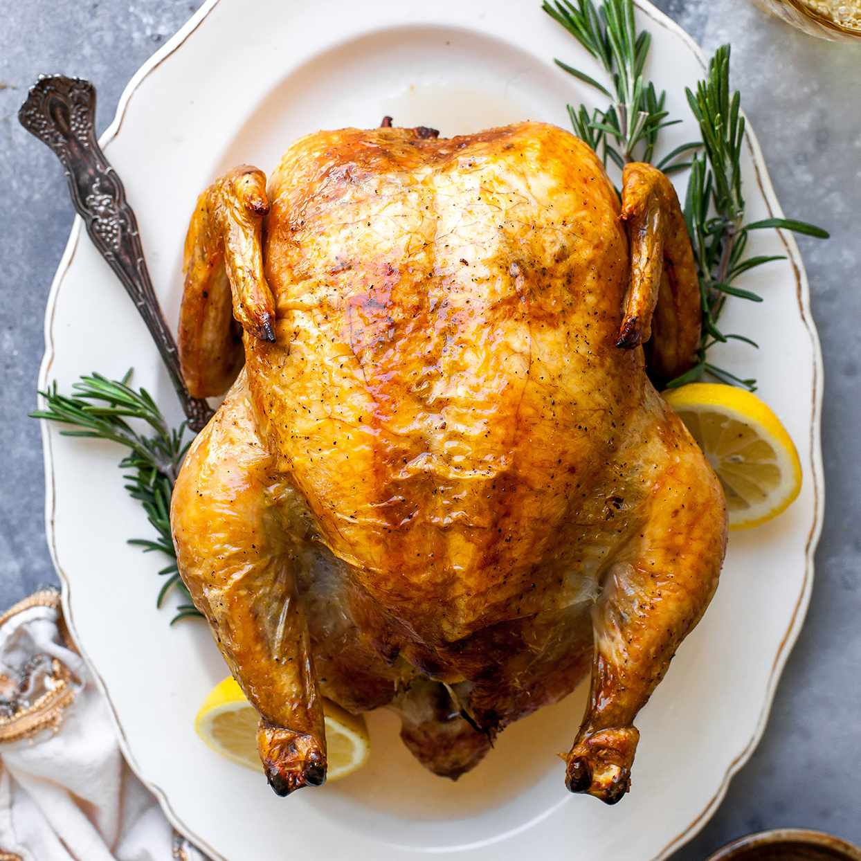

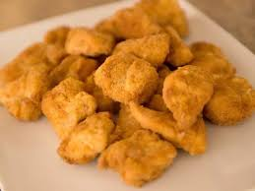
Meat, chicken and fish give us protein and nutrients to build our muscles.

Slide 6
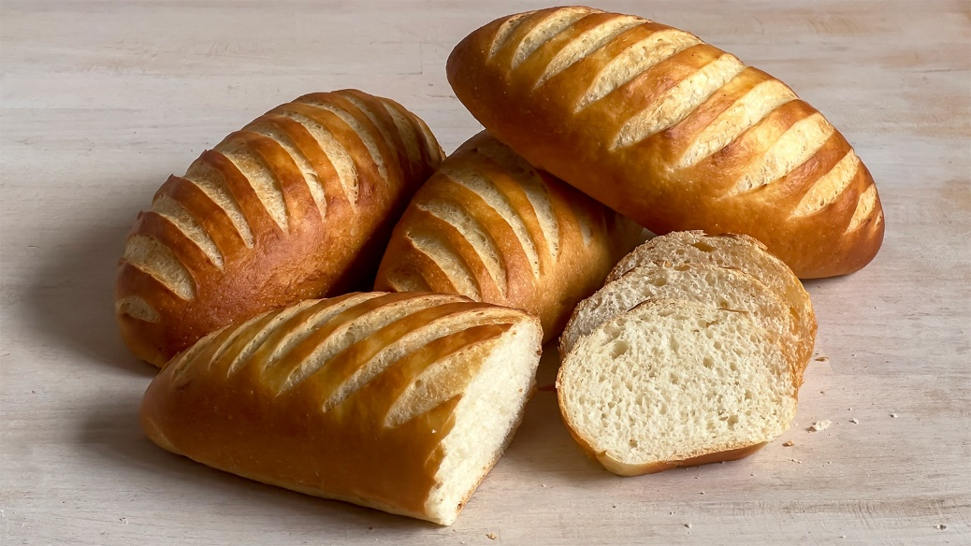
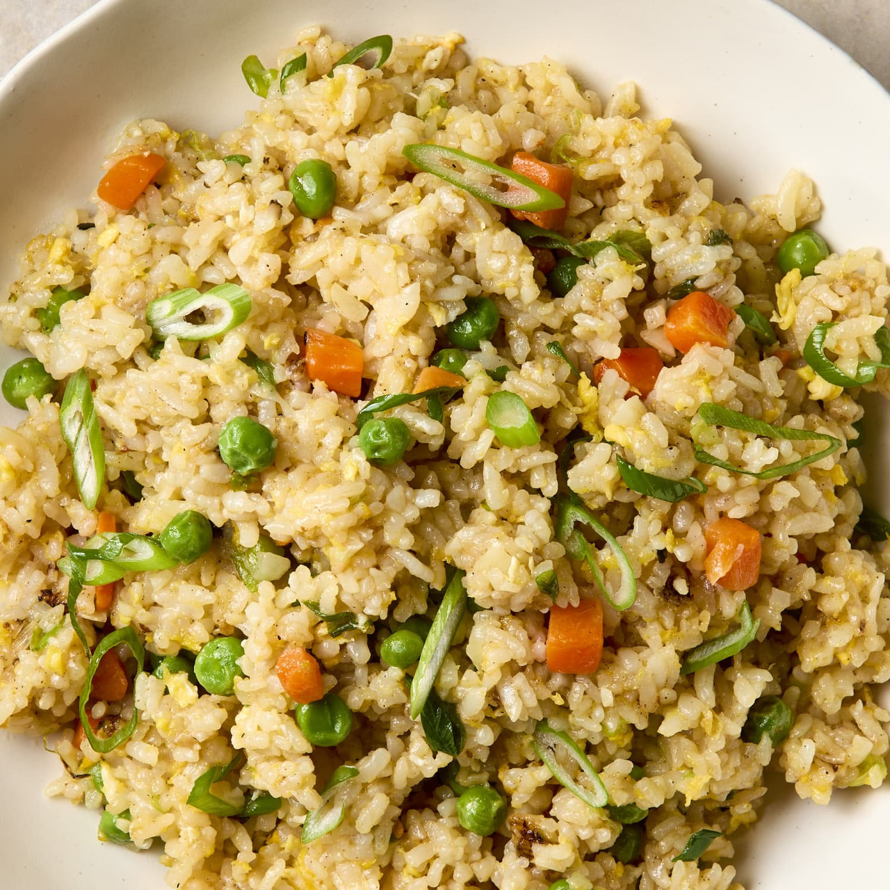
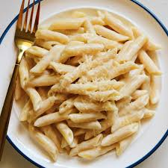
Rice, bread and pasta give us fiber and vitamins to help us digest our food.

Slide 7
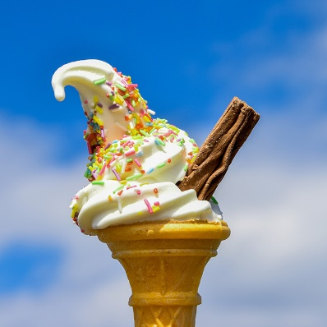
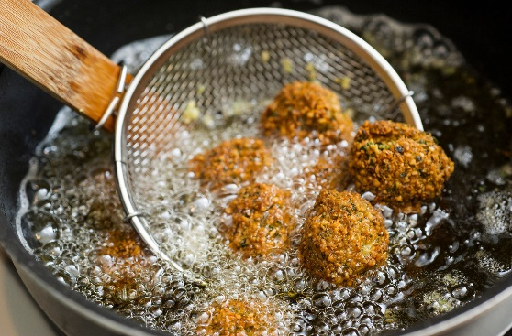
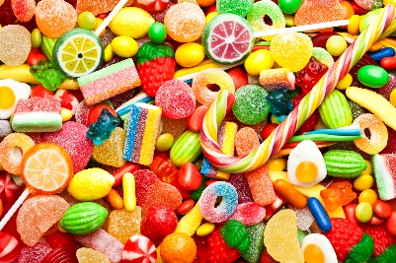
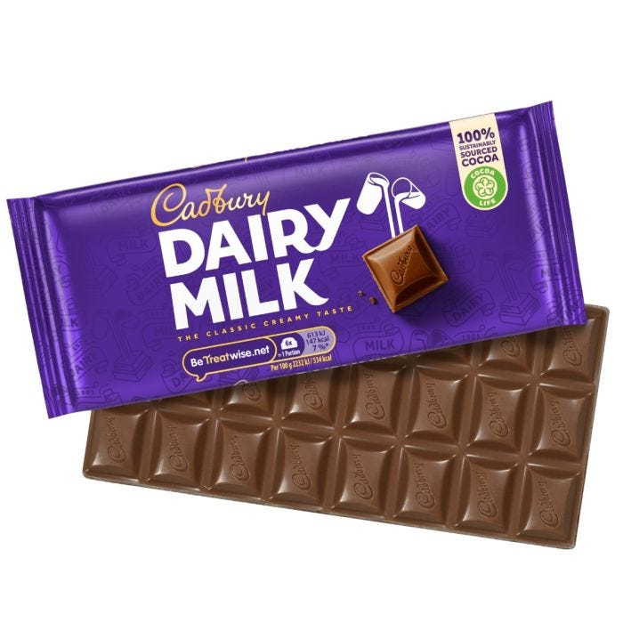
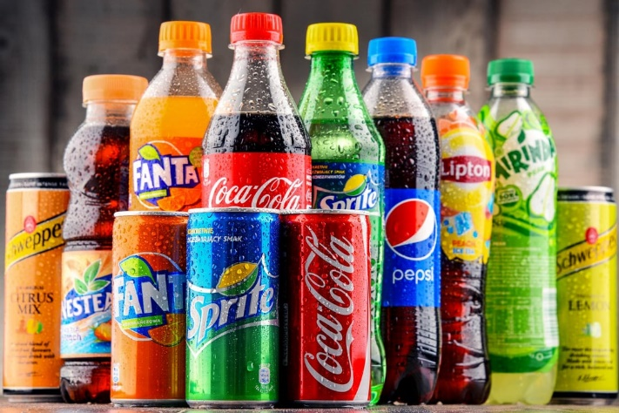
We can still eat foods that are not very healthy, but we should only eat little amounts of these foods as they can be bad for our bodies if we eat too much.
E.g. sugar, sweets, chocolates, too much oil and fried foods

Slide 8
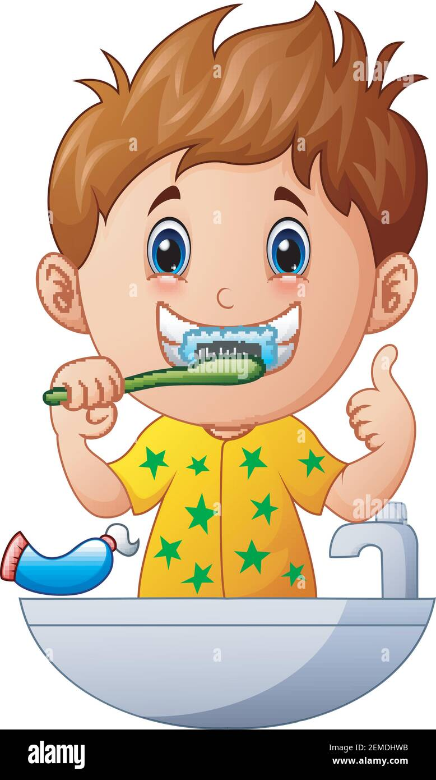
We need to remember to brush our teeth after eating foods that contain lots of sugar .

Slide 9
Practical activity
(Resources: 2 plates, healthy/lots symbol, unhealthy/little symbol, selection of foods/pictures).
Place to two plates on the floor.
Explain the symbols
-healthy: we need to eat lots of these food
-not so healthy: we need to eat little amounts of this food
Encourage children to sort the foods on the plates.

