Slide 1


Slide 2
What does privacy mean?
Something that belongs to you, or you would like to keep to yourself,
e.g. information, object, your body

Slide 3
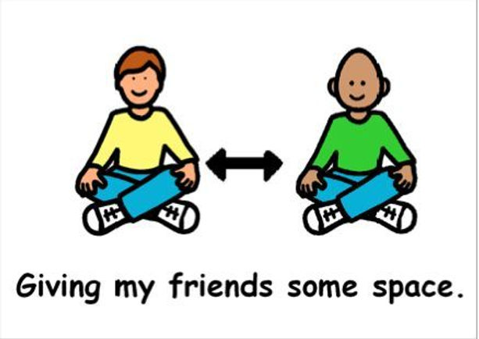
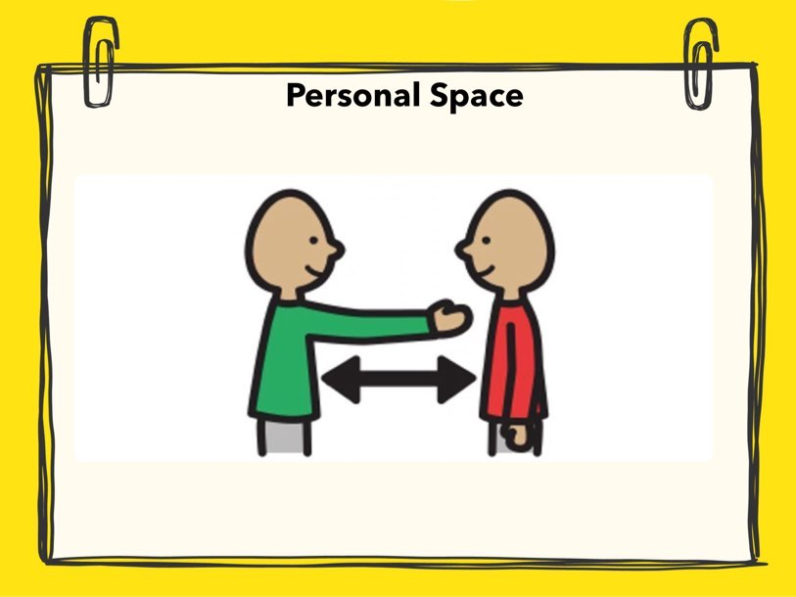
Explain: What Personal Space Looks Like
It is important to give others and your self some space so you are not too close to someone or something.
Practice: Get the children to stand really close to each other and ask them to turn, jump, wave arms. Explain if they are touching someone else that means they are too close. Try again by spacing out.

Slide 4
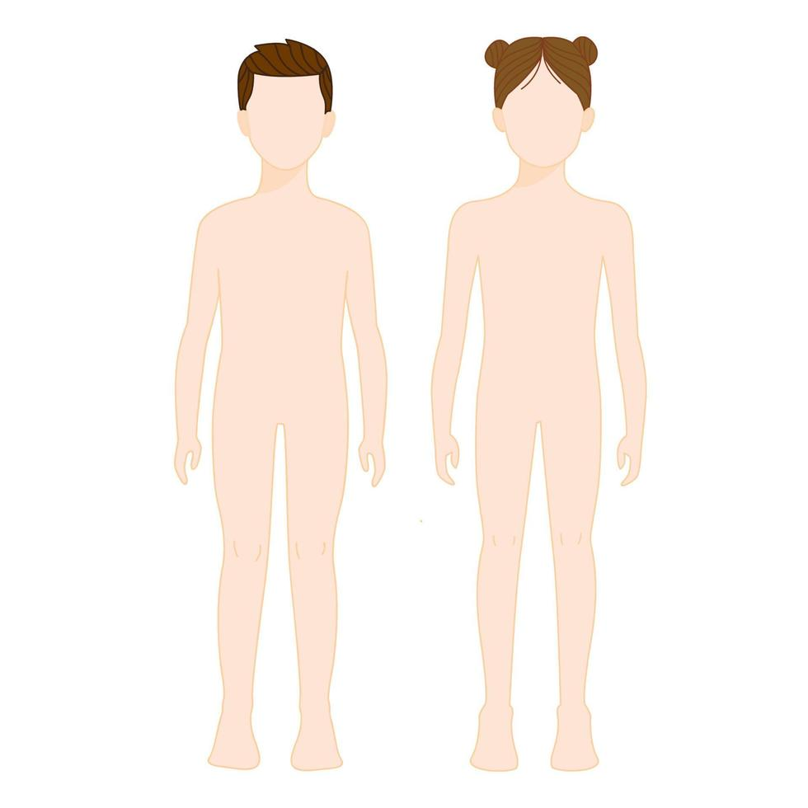
Explain: Body Privacy
We have private body parts.
What are your private body parts?
We should keep these body parts covered because they belong to us.
Explain: Your body belongs to you. If you don’t want anyone to touch you then you need to say ‘stop’.

Slide 5
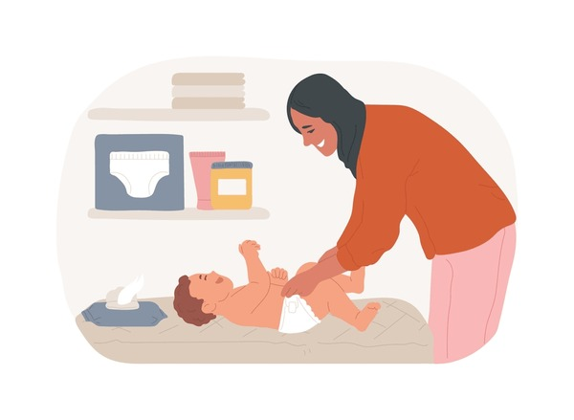
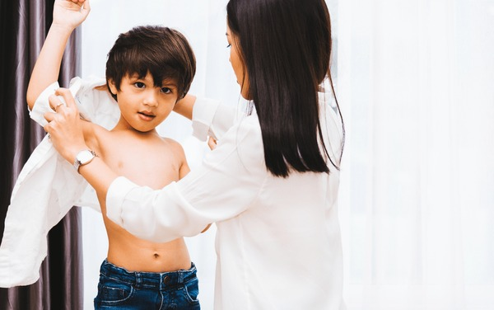
Rules and social expectations
Explain: How Consent Works
It is important to ask someone if you can touch them before you do.
It is also important for others to ask you for you for your consent before they touch you.
Examples:
Nappy changing
Giving or receiving a massage
Holding hands
Helping with clothing
Practice:
What can you say if you want to hold your friends hand?
What can you say if you want to help your friend put their coat on?

Slide 6


Explain: Privacy when going to the toilet
You must close the door when you go to the toilet.
It is important nobody sees you private body parts
Explain they will see this right in the toilets because they have the right to privacy and should have their door closed when they use the toilet so nobody else can see them.

Slide 7

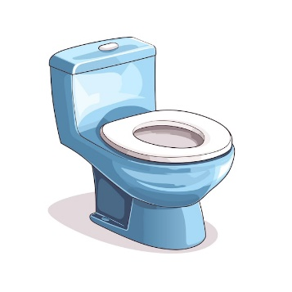


You should close the door when you go to the toilet so others cant see you.

Slide 8

Difference between secrets and surprises
Secret: Is when someone tells you not to share something with anyone else. (If this is making you sad or is wrong then you must share this with you parents, siblings or teachers)
Surprise: Is when you are planning something special for someone and then you will share it with them e.g. birthday or a present

